Slide 1


Artificial Intelligence and Data Science
Data Science and Visualization
24ADI204
DATA-VIZ HACK-A-BIT (2026-2027)
MID REVIEW (September 2026)
Team Number: 17
"The Heat Is On: A Visual Timeline of Global Warming"
Preview of the final “warming stripes” visualization style

Slide 2
Problem Statement
Why this project matters:
Rising global temperatures are reshaping weather, sea levels and ecosystems, but the scale of this change is hard to grasp from raw numbers alone.
This project uses 124 years of country-level climate data (1900-2023) to show, in a clear visual way, how much the planet has actually warmed and where that warming is happening fastest.
1900–2023
Years of climate data
195
Countries covered
100,000
Records analyzed

Slide 3
Project Objectives
  We explore historical temperature anomaly data from 1900 to 2023 across 195 countries.
  We identify long-term warming trends and patterns across different regions and decades.
  We clean the dataset thoroughly, handling missing values and outliers so the analysis stays reliable.
  We aim to build a clear, animated "warming stripes" visualization that communicates climate change simply.
  We document our process clearly each week so our GitHub repo tells the full story of the project.

Slide 4
Scope of the Project
What's in scope, and what isn't:
This project covers the Global Warming dataset (1900-2023): 100,000 records across 195 countries and 26 indicators, including temperature anomaly, CO2 emissions, population, forest area and renewable energy usage.
The scope includes data cleaning, exploratory data analysis, and visualization, specifically building an animated heatmap of temperature anomalies over time. It does not include predictive modeling; the focus is on understanding and visually communicating what has already happened to the climate over the last century.
100,000
Records
195
Countries
26
Indicators tracked

Slide 5
Dataset Description
Here are the key details of our dataset:
  The dataset comes from a structured CSV file provided for the course, called Global_Warming_Dataset.csv.
  The variable we study most closely throughout the project is Temperature_Anomaly.
  The data is structured and almost entirely numeric, with Country as the only categorical field.
100,000
Records
195
Countries
26
Columns
1900–2023
Years covered

Slide 6
Methodology(Process / Workflow)
Here is our workflow so far, covering Weeks 1 through 4:
  In Week 1, we selected the Global Warming dataset and set up our GitHub repository.
  In Week 2, we explored the raw dataset's structure, checked column types, and put together a "first impression" report.
  In Week 3, we cleaned the data with median imputation on six columns, removed duplicate rows, and removed outliers flagged by both the IQR and Z-score methods.
  In Week 4, we explored the data through univariate and bivariate analysis, a correlation heatmap, and several trend charts.
  Weeks 5 and 6 are still ahead: feature engineering and building the final animated heatmap.
Dataset structure we confirmed in Week 2 (used to guide Week 3 cleaning):
Column | Type | Example value | Notes
Country | Text | Country_103 | 195 unique values
Year | Integer | 1913 | Range: 1900-2023
Temperature_Anomaly | Decimal | -1.16 | Primary variable
CO2_Emissions | Decimal | 887,606,100 | Outlier column, cleaned via Z-score
Outlier check example (IQR method)
Column: CO2_Emissions
Q1 = 250.4M Q3 = 750.6M
IQR = Q3 - Q1 = 500.2M
Upper bound = Q3 + 1.5 x IQR ≈ 1,501M
150 values (0.15%) exceeded this bound and were removed as outliers.

Slide 7
Results From Workflow
Cleaning results from Week 3:
  We filled missing values in six columns using median imputation, removed duplicate rows, and validated the Year (1900-2023) and Country (195 unique) fields. We also detected outliers using both the IQR and Z-score methods and removed rows with a Z-score above 3, cutting outliers from 949 to 59. This resulted in a fully clean dataset, Global_Warming_Fully_Cleaned.csv, with zero missing values, zero duplicates and no extreme outliers.

Slide 8
Results From Workflow
Results from Week 4's exploratory data analysis:
  We reviewed the mean, median and spread of temperature anomaly and other indicators through summary statistics.
  We looked at the distribution of Temperature_Anomaly using histograms, KDE plots, boxplots and violin plots.
  We checked correlations with a heatmap and a CO2-vs-temperature scatter and regression plot.
  Our key insight: some countries and recent decades show clearly higher average anomalies than others.

Slide 9
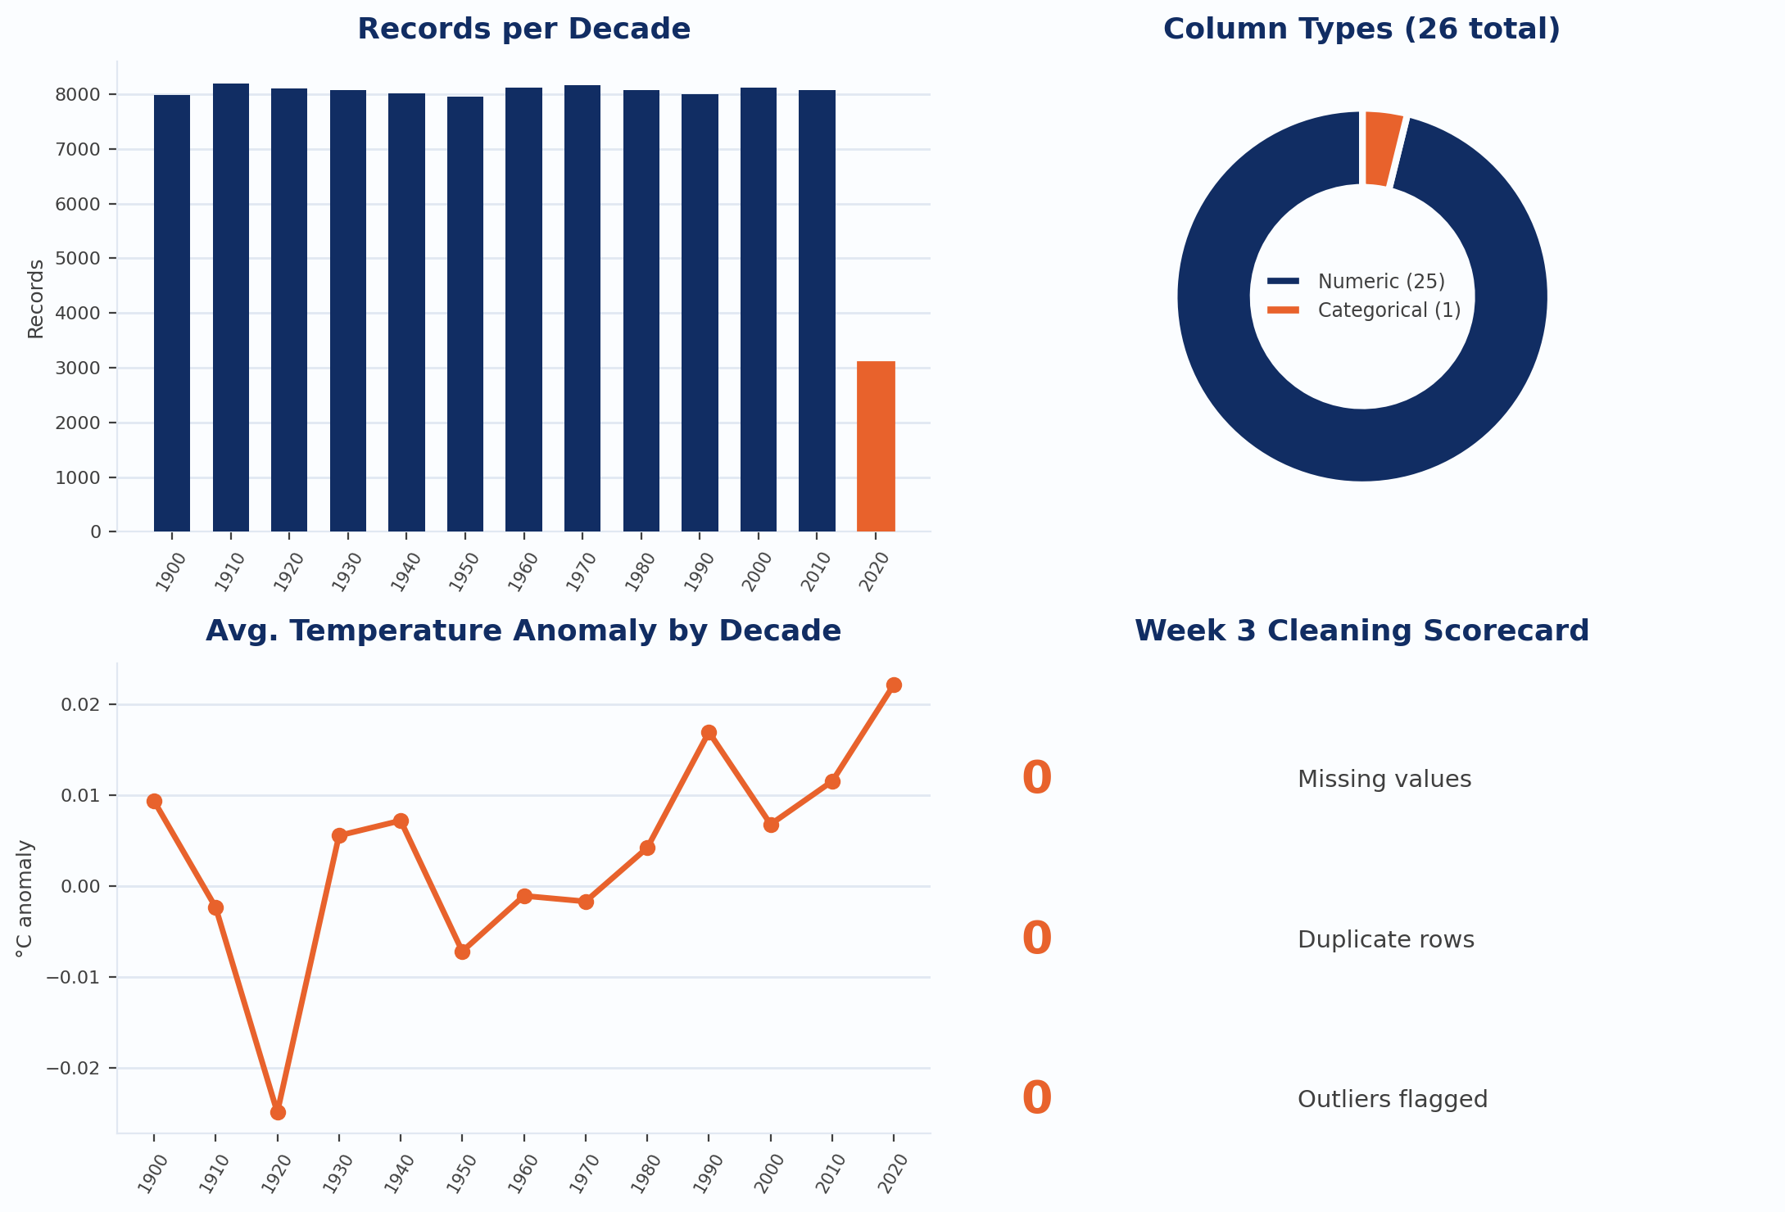
Data Quality & EDA Dashboard (Weeks 1–4)
A quick snapshot of the dataset we cleaned and explored in Weeks 1–4:

Slide 10
Expected Final Results
Our plan for Weeks 5 and 6, and what we expect by the end:
  Feature engineering: we will group the data by decade and region to prepare it for the final visualization.
  Final data quality: zero missing values, zero duplicates, no extreme outliers, and every field validated, exactly as achieved in Week 3.
  Final deliverable: an animated "warming stripes" heatmap that clearly communicates long-term temperature change across countries and decades.

Slide 11
Roles & Responsibilities
Team Member | Roles & Responsibilities
V Jayavanadhi | Data Analyst
Gurupriya | Data Engineer
Manoj SS | Visualization Expert
Joyce Laetitia Malenou Weudji | Storyteller

Slide 12
Challenges Faced
Here are the challenges we ran into along the way:
  Missing values appeared in six columns, so we had to impute them carefully without distorting the real climate trends.
  Some countries and years had far more records than others, so we averaged our comparisons instead of relying on raw counts.
  Several columns contained extreme outliers, so we used both the IQR and Z-score methods together to confirm which values were genuine extremes.
  Understanding 26 unlabeled columns with no data dictionary meant carefully inferring what each one measured before deciding how to clean it.
  Coordinating GitHub uploads across the team took some early trial and error before our workflow settled.

Slide 13
Future Work & Conclusion
Where we stand, and what's next:
Weeks 5 and 6 will focus on feature engineering (decade and region grouping) and building the final animated heatmap.
Overall, the project has successfully cleaned and explored a 99,054-record climate dataset through Week 4, revealing meaningful variation in temperature anomalies across countries and decades, a solid, reliable foundation for the final visual story of global warming.
0
Missing values remaining
99,054
Records cleaned
4
Weeks completed

Slide 14
References
Global_Warming_Dataset.csv: course-provided dataset for 24ADI204 Data Science and Visualization
Pandas Documentation: pandas.pydata.org
Matplotlib Documentation: matplotlib.org
Seaborn Documentation: seaborn.pydata.org
SciPy Documentation (stats.zscore): scipy.org

